Slide 1

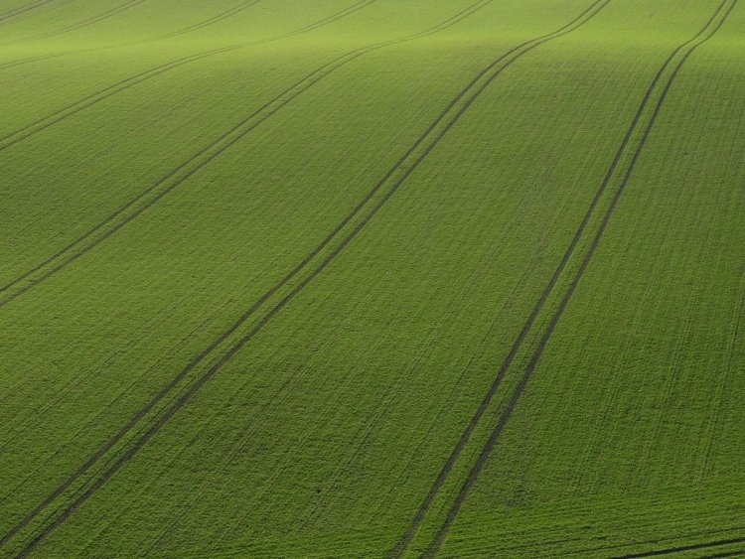


Report on the preparatory work
for dual training of students
in the educational program “Agroecology”
Toraighyrov University
July, 2024

Slide 2
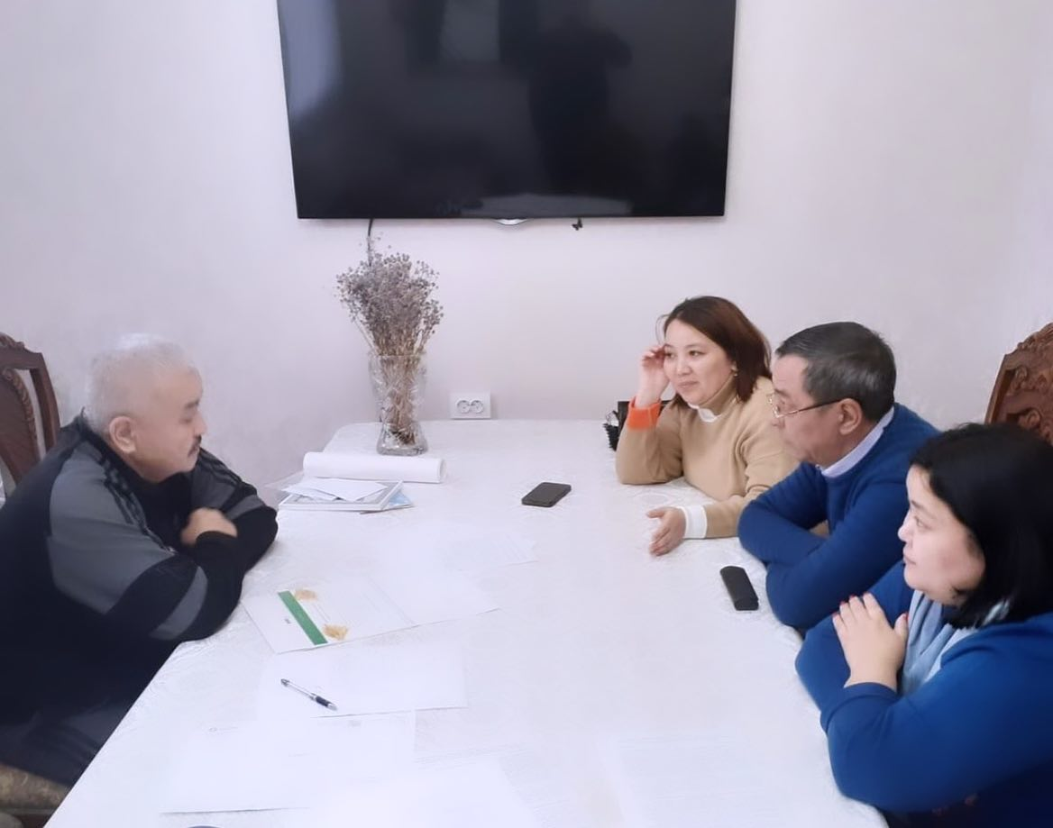
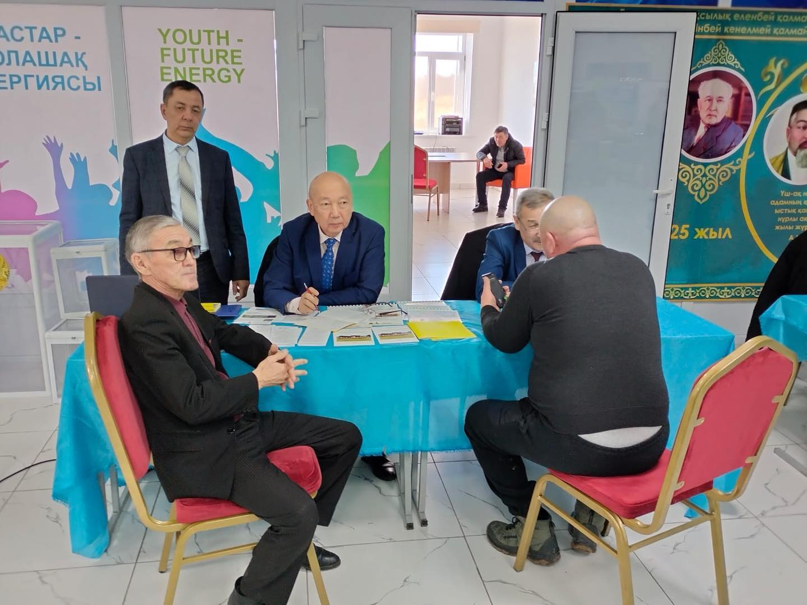
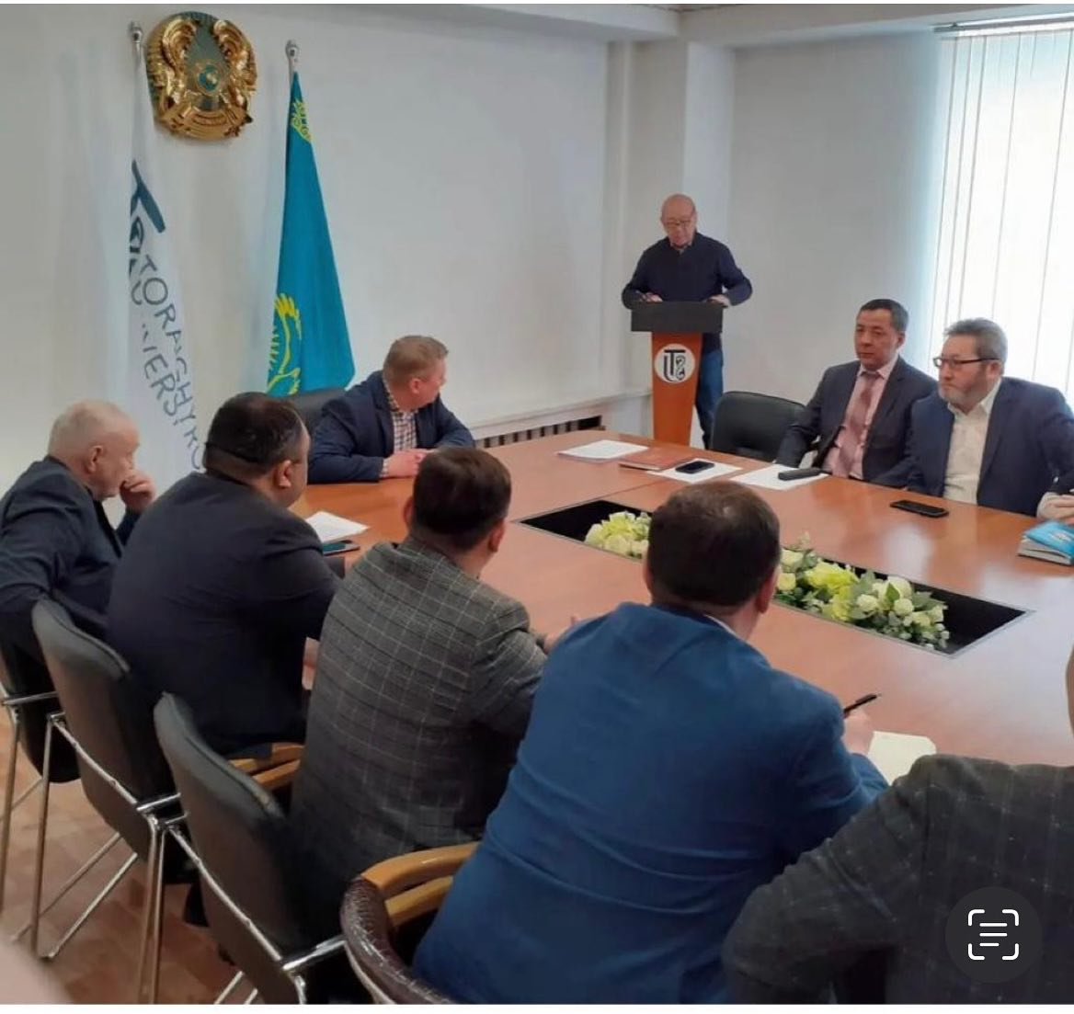
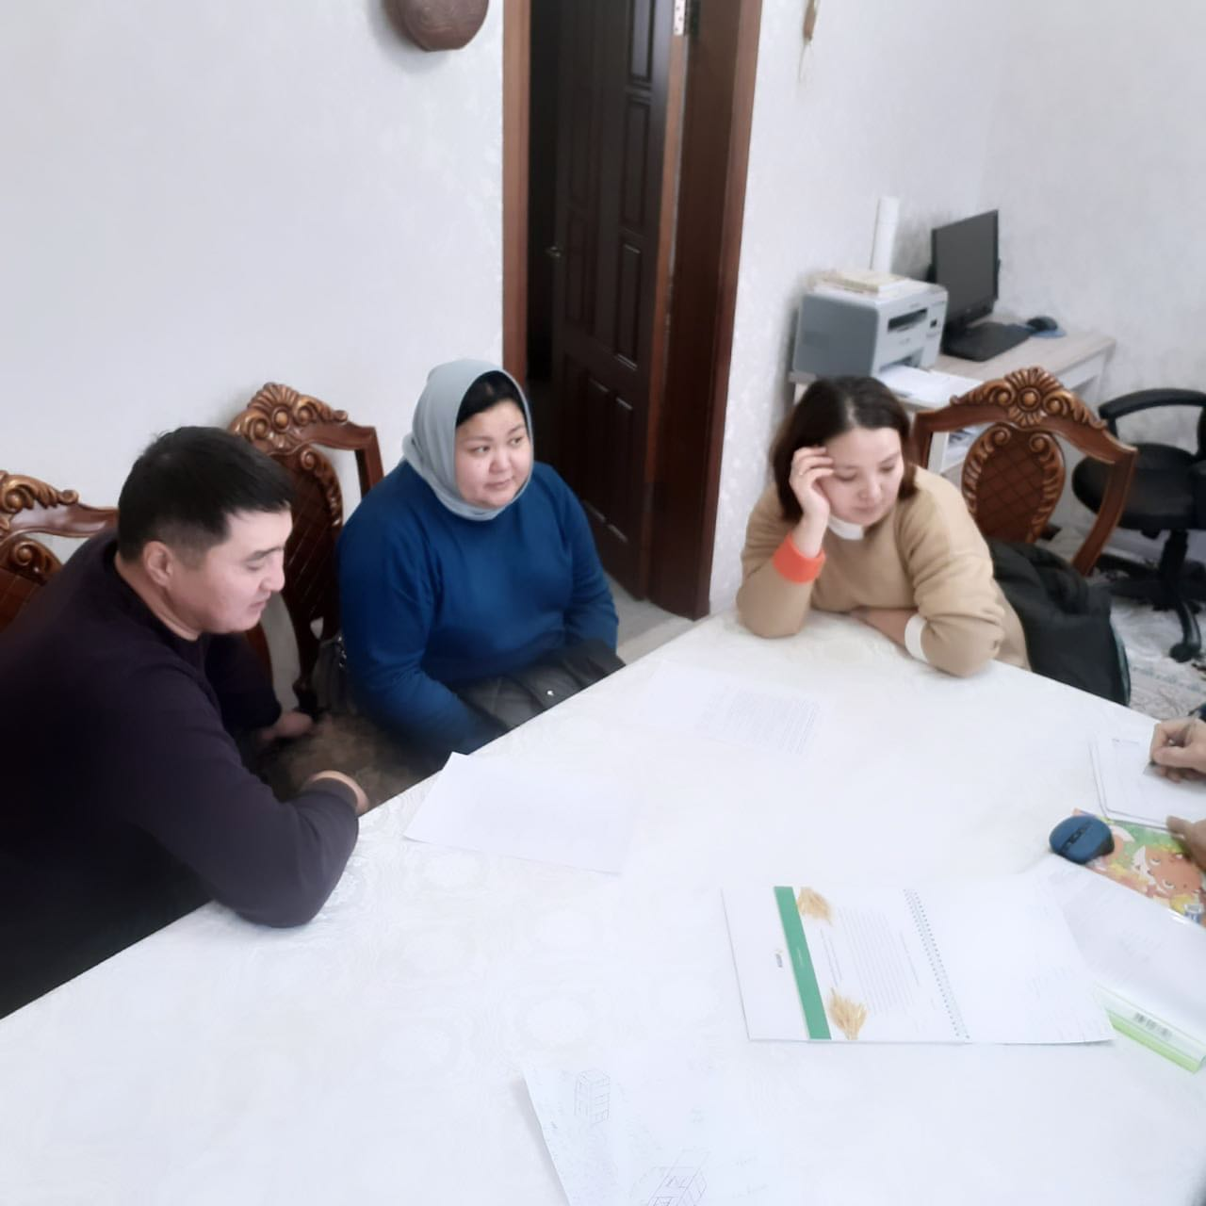
A working meeting was held at ToU
to discuss practical training for students
educational program «Agroecology»

Slide 3
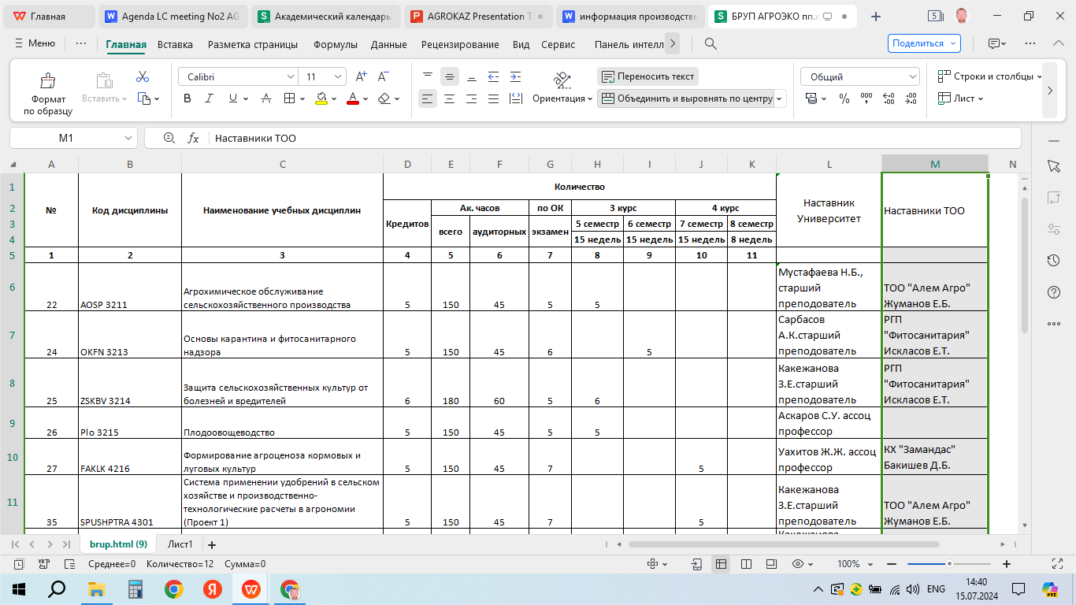
Curriculum

Slide 4
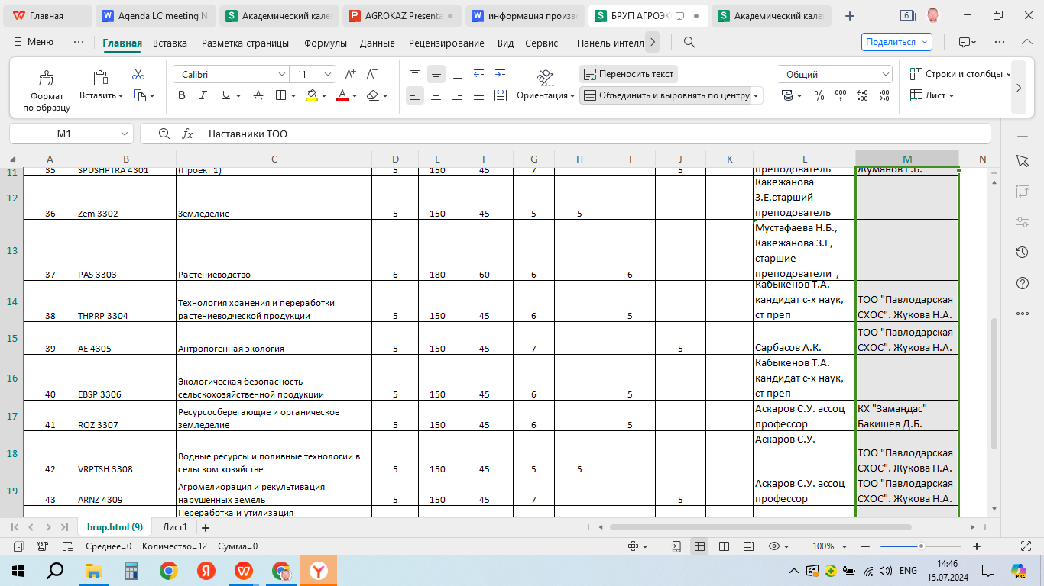
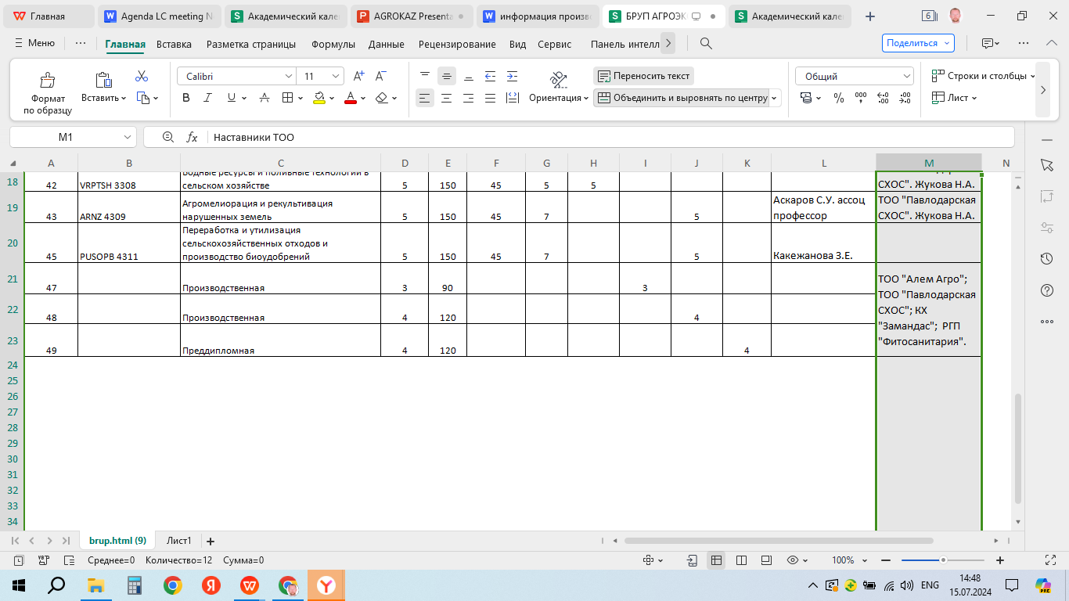

Slide 5

Schedule of the educational process

Slide 6
The ratio of hours of theory and practice over four years
During the period of industrial and pre-graduate internships 3-5 students
will be employed under a contract with payment.

Slide 7
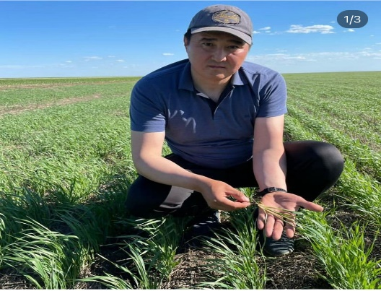

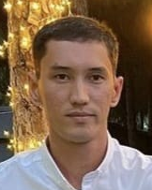
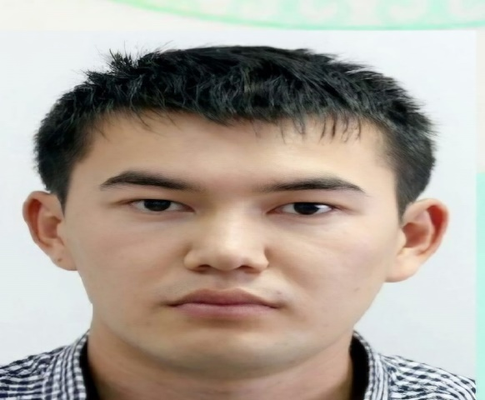
Mentors identified for practical training of students
Bakishev Daulet Balgabaevich Director of the farm "Zamandas", Master of Agricultural Sciences
Zhukova Natalia
Researcher, Pavlodar Agricultural Experimental Station, Master of Agronomy, Postgraduate Student, Omsk State Agrarian University named after P. Stolypin
Zhumanov Erik Bolatovich Territorial Manager for Pavlodar Region, Alem agro Holding LLP, Master of Agricultural Sciences
Iklasov Ernur Tusupovich
Head of the Department of State Inspection for Plant Quarantine and Phytosanitary Control Posts, State Institution "Pavlodar"

Slide 8
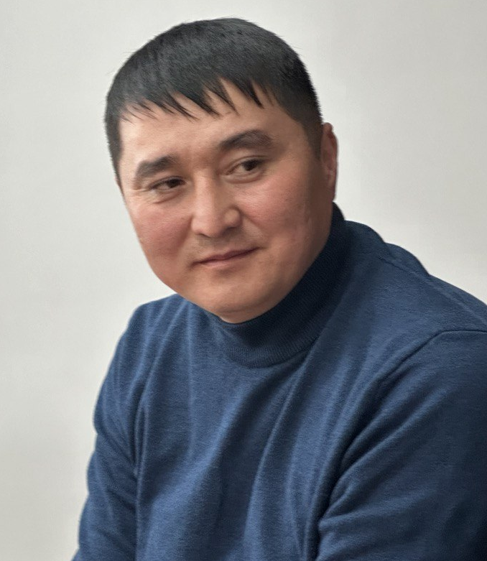
Farm "Zamandas"
Discipline: Formation of agrocenosis of fodder and meadow crops
Competencies: The discipline is aimed at mastering the techniques of cultivation of fodder crops on arable land, hayfields and pastures by students. Students will study the biological characteristics of forage plants, ways to increase the yield of natural forage lands and field forage, with an assessment of their nutritional value, modern technologies for harvesting and growing forage crops.
Discipline: Resource-saving and organic farming
Competencies: Students will learn how to make links in the farming system and their interaction, identify the most promising farming systems and agricultural crop cultivation technologies for specific agroecology conditions, rational tillage systems in crop rotations to create optimal conditions for the growth and development of agricultural crops and the preservation of soil fertility, a set and sequence of implementation techniques tillage for various agricultural crops to create the specified soil properties with minimal energy costs for the agro-industrial complex.
Mentor – Bakishev Daulet Balgabaevich Director of the farm "Zamandas", Master of Agricultural Sciences

Slide 9

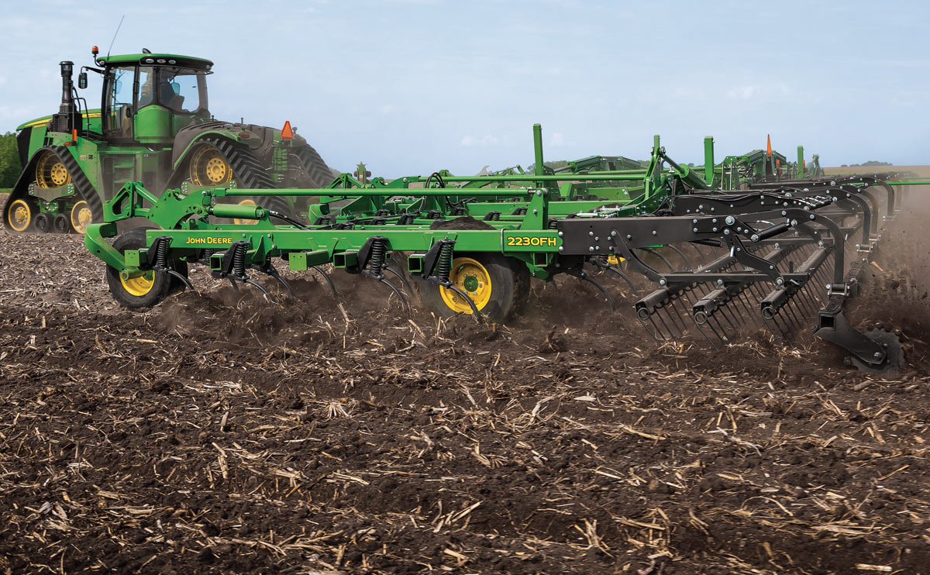
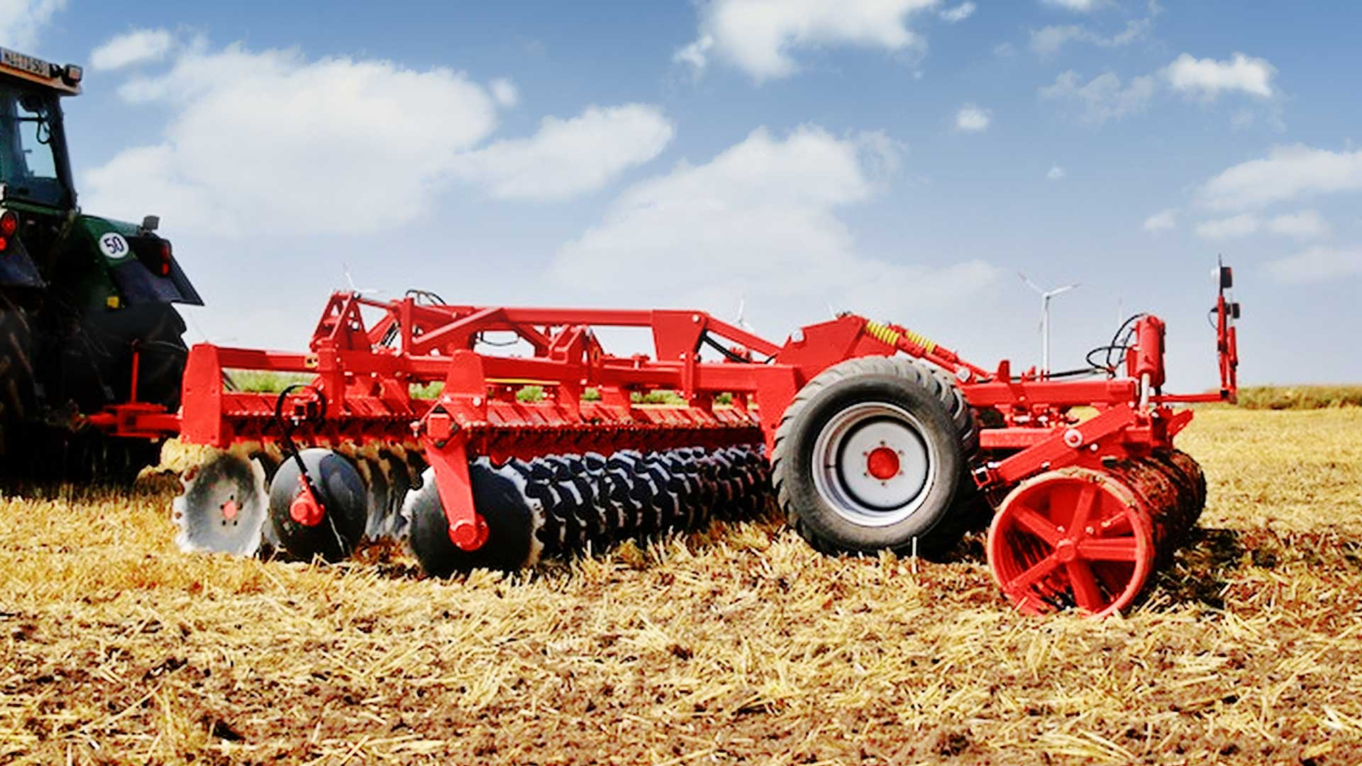
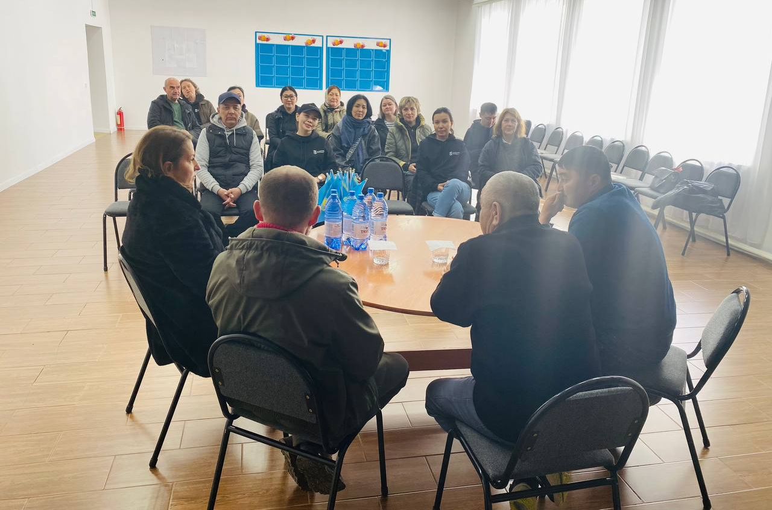
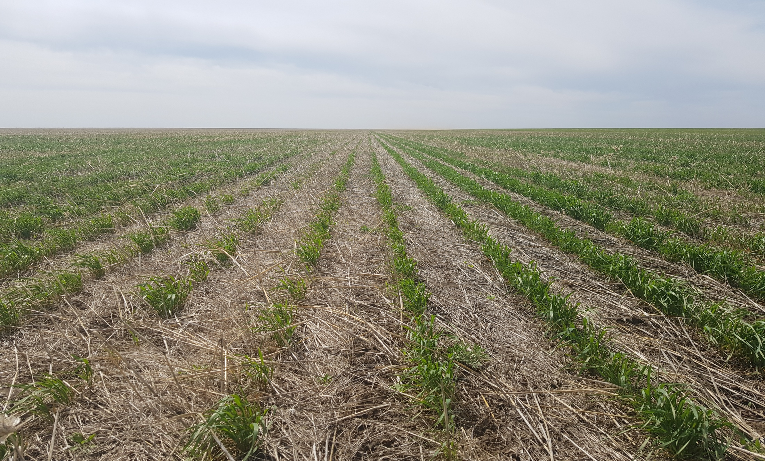
For practical training of students, the farm "Zamandas" has:
Machine and tractor park
Classroom
Scientific experimental fields

Slide 10
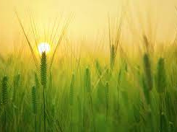

THANK YOU!
@agrokaz__

